Slide 1
Let’s
Talk Testing
Lindy Dunn
Test Coordinator

Slide 2
Understanding Georgia Milestones

Slide 3
You are the classroom expert!
You work hard!!!
Your students work hard!

Slide 4
3rd grade:
ELA & Math
4th grade:
ELA & Math
5th grade:
ELA, Math, Science

Slide 5
6th grade:
ELA & Math
7th grade:
ELA & Math
8th grade:
ELA, Math, Science, Social Studies

Slide 6
The Georgia Milestones Assessment System (Georgia Milestones) is an annual test given to students in grades 3 -12. The Georgia Milestones measures how well students have mastered the skills outlined in the state-adopted standards for English Language Arts (ELA), Mathematics, Science, and Social Studies

Slide 7
What is different about the Georgia milestones when compared to Other state assessments?
One of the biggest differences between Georgia Milestones and other state tests is the increased difficulty, sometimes called rigor, which is required to match the test to our state standards.
The Georgia Milestones features open-ended questions for which students must create a written response rather than choosing a multiple choice answer. Some questions require students to give a reason for the answer they chose or to identify why an answer provided may not be correct.

Slide 8
Example:
The following are examples to show you the difference in what used to be shown, and what is currently on the test for students.

Slide 9
Basic Question
Solve this equation:
½ ÷ 8=
A. 8/16
B. 1/16
C. 4
D. 1/64
GMAS type Question
Which problem could the expression below help solve?
½ ÷ 8=
A. How much total feed will 2 chickens eat if each chicken is given 1/8 pounds of feed?
B. How much milk will each child get if 8 children share ½ gallon of milk equally?
C. If each cake requires ½ cup of milk, how much milk will be used to make 8 cakes?
D. Sixteen children are divided into 2 equal groups. If each child receives 8 pieces of candy, how many pieces of candy are required for each group of children?

Slide 10
Here is an example of a 3rd grade ELA Constructed Response:
How are the main points in “The Story of Money” different from the main points in “Make Your Money Work for You”?
Use details from BOTH passages to support your answer. Please type your answer in the box provided.
After reading two passages the student must write an essay about the differences between the two passages rather than answering multiple choice questions about a single passage.

Slide 11
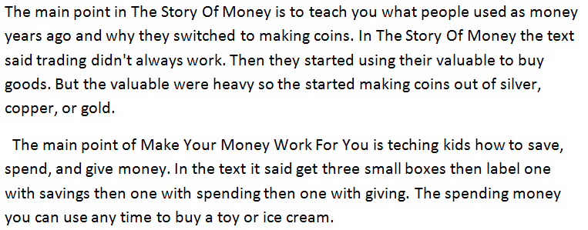
Here is a response to the previous question that gets full Credit :

Slide 12
Here is a response to the previous question that gets partial Credit :

Slide 13
Here is a response to the previous question that gets No Credit :
There are no supporting details and the student response refers to the main point of only one of the two passages.

Slide 14
Number of Questions:
Subject | # of total Questions
ELA | 51
Math | 55
Science | 42
Social Studies | 42

Slide 15
Number of Questions and Breakdown

Slide 16
Number of Questions and Breakdown

Slide 17
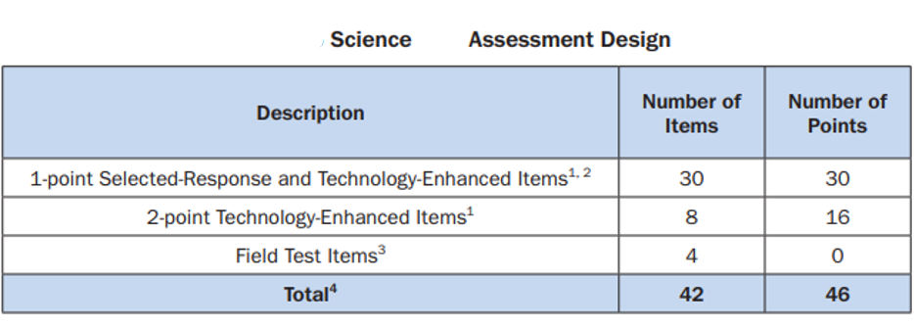
Number of Questions and Breakdown

Slide 18
Number of Questions and Breakdown
Social Studies

Slide 19
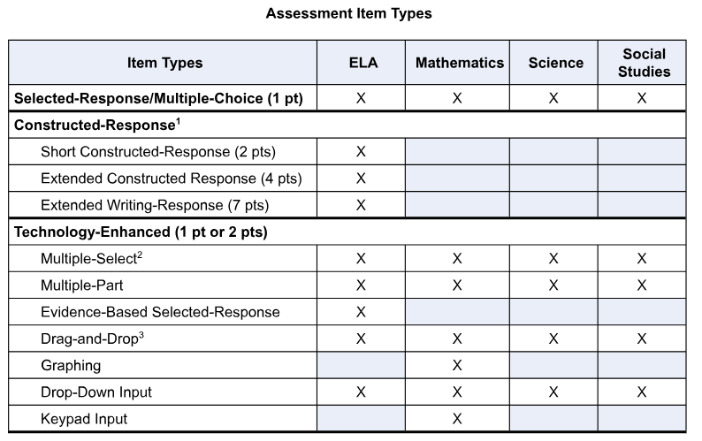
Number of Questions and Breakdown

Slide 20
Testing Time
These are “Standard times” and do not reflect Extended time accommodations
(Per IEP, 504, or TCP Paperwork)

Slide 21
When is Testing? (Elementary)
Monday | Tuesday | Wednesday | Thursday | Friday
22 ELA Section 1 | 23 ELA Section 2 | 24 ELA Section 3 | 25 Math Section 1 | 26 Math Section 2
29 Science | 30 Makeup Testing | 1 Makeup Testing | 2 Makeup Testing | 3 Makeup Testing

Slide 22
When is Testing? (Middle)
Monday | Tuesday | Wednesday | Thursday | Friday
22 ELA Section 1 | 23 ELA Sections 2/3 | 24 Math or *Algebra* | 25 Science or *Physical Science | 26 Social Studies
29 8th Math (for those who took the Algebra test) | 30 Makeup Testing | 1 Makeup Testing | 2 Makeup Testing | 3 Makeup Testing

Slide 23
This year- the Math scores will not come back until September or later…
Scores?
ELA Scores should come back the 1st or 2nd week in May!

Slide 24
What Happens if my student does not meet grade level?!
3rd and 5th grade ELA will have re-takes this year if the students do not meet the Lexile cut-off for ELA
3rd- 520
4th- 740 (But they do not re-take)
5th- 830

Slide 25
What Happens if my student does not meet grade level?!
8th grade ELA will have re-takes this year if the students do not meet the Lexile cut-off for ELA
6th- 925 (But they do not re-take)
7th- 970 (But they do not re-take)
8th- 1010

Slide 26
When will Re-Takes Happen?
May:
15th & 16th

Slide 27
http://www.gaexperienceonline.com/

Slide 28
http://www.gaexperienceonline.com/

Slide 29
http://www.gaexperienceonline.com/

Slide 30
http://www.gaexperienceonline.com/

Slide 31
Best Tips for State Testing: - Work hard all year (This isn’t something you can “cram for”) - Maintain a study habit on a regular basis - Get plenty of rest -TAKE YOUR TIME on the test- it isn’t a race - Continue your normal morning routine during testing (including breakfast) - Ensure your device is charged

Slide 32
Questions?
Lindy Dunn
Dunn.lindy.m@muscogee.k12.ga.us

