Slide 1













DOUBLE CHURCHES MIDDLE SCHOOL
Georgia Milestones Information 2023-2024

Slide 2

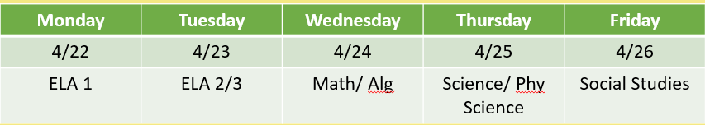
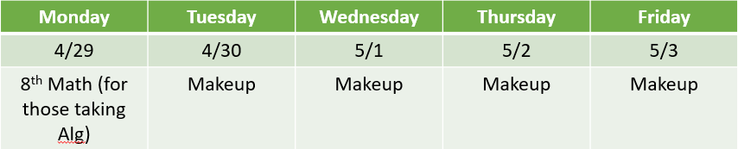


GMAS testing week

Slide 3


gmas test design
1.
Students are allowed up to the maximum testing time to complete the assessment.
2.
Examiners must adhere to the testing times
prescribed in the Test Administration Manuals and scripts.
3.
Allowing too much or too little
time may result in an invalidation.

Slide 4

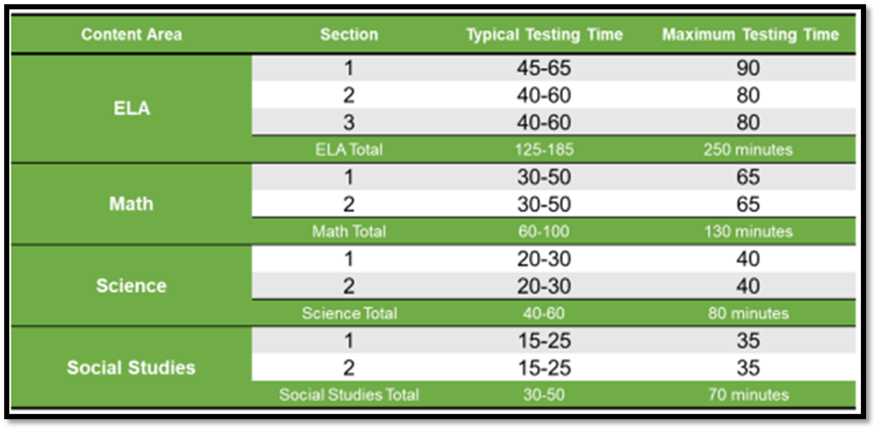


Slide 5



Allowed Scratch Paper
•Blank paper
•Lined paper
•¼ blank graph paper
scratch paper and calculator policy
Calculator Policy
All grades 6-high school – test takers should be trained in the use of the online Desmos Calculator embedded in the practice tests

Slide 6


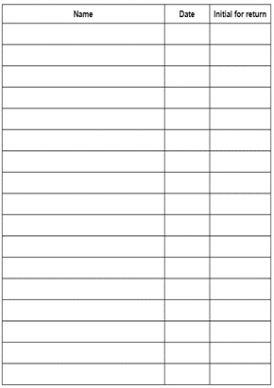

cell phone plan
Students will power off and put cell phones in a labeled envelope. Students will get it back in their possession after all testing materials are out of the classroom.

Slide 7



GMAS retakes
  May 15th and 16th
  **Retakes will just be 2 ELA sections**
  Student test scores will be distributed before the end of the school year

Slide 8


What can i do?
GMAS scores from 2023-2024 will determine what
class your 6th or 7th grader will be enrolled in next year.
  Make sure your student eats a good breakfast
  Minimize late night sports
  Get a good night’s sleep
  minimize screen time late at night
Teachers should make sure students are familiar with the new enhanced student experience using
Experience Online Testing Georgia
http://www.gaexperienceonline.com/

Slide 9


