Slide 1
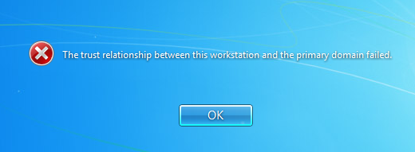
Trust Relationships and you

Slide 2
Why do they happen?
Nobody knows!
Expired machine account passwords? Kerberos?

Slide 3
How can I fix my relationship?
Rejoin to domain

Slide 4
Steps to rejoin a Win 8.1 PC to the domain:
CP>System and Security>System, Change Settings link
Computer tab>Change button
Choose workgroup radio button, name it anything
Change button again
Choose domain, insert mcsd.internal
OK, reboot

Slide 5
Can this be done remotely?
You bet!
Make sure PC is on and plugged in to the network…
Retrieve computer name from spreadsheet via V number…
Make sure it pings…

Slide 6
Steps for remoting An untrusted win 8.1 pc
Find PC in AD, Disable, Enable, Reset
Use mstsc to remote
Use account .\hvac and the usual password
Follow the same steps
Confirm with user

