Slide 2
Comprehensive
Although broken into End of Grade (EOG) and End of Course (EOC) sub sections, the Georgia Milestones Assessment System is a single program, and not a series of tests (CRCT, EOCT, Graduation Test, Writing Test)
Formative Assessment tools to complement summative
Coming Fall 2014: Georgia Formative Online Assessment Resource (GOFAR) within the SLDS

Slide 3
Levels
Grades 3 – 8
End of Grade (EOG) in language arts, mathematics, science, social studies
High School
End of Course (EOC) in 9th Grade Literature & Composition, American Literature & Composition, Coordinate Algebra, Analytic Geometry, Physical Science, Biology, US History, and Economics

Slide 4
COHERENT
Consistent expectations and rigor to position Georgia students to compete with peers nationally and internationally.
Consistent Signal about student achievement both within the system (across grades and courses) and with external measures

Slide 5
COHERENT
Georgia Milestones will provide:
Criterion-referenced performance information in the form of four performance levels, depicting students’ mastery of state standards
Norm-referenced performance information in the form of national percentiles, depicting how students’ achievement compares to peers nationally

Slide 6
Transition to online testing
Year 1: minimum of 30% online across the district, grades 3-12
Year 3: minimum of 80% online across the district, grades 3-12
Year 5: minimum of 100% online across the district, grades 3-12
All schools in all districts are expected to conduct some degree of testing online in 2014-2015 . . . and of course, subsequent years.

Slide 7
Unique Features
inclusion of constructed-response items in ELA and mathematics, in addition to selected-response items
inclusion of a writing component (in response to text) at every grade level and course within the ELA assessment;
transition to online administration over time, with online administration considered the primary mode of administration and paper-pencil back-up until transition is completed.
Addition of technology-enhanced items beginning 2016-2017

Slide 8
Item Types: Overview
Selected-Response [aka, multiple-choice]
all content areas
evidence-based selected response in ELA
Constructed-Response
ELA and mathematics
Extended-Response
ELA and mathematics
Technology Enhanced
to begin in 2016-2017
Constructed response is a general term for assessment items that require the student to generate a response as opposed to selecting a response.
Extended-response items require more elaborate answers and explanations of reasoning. They allow for multiple correct answers and/or varying methods of arriving at the correct answer. Writing prompts and performance tasks are examples of extended-response items.

Slide 9
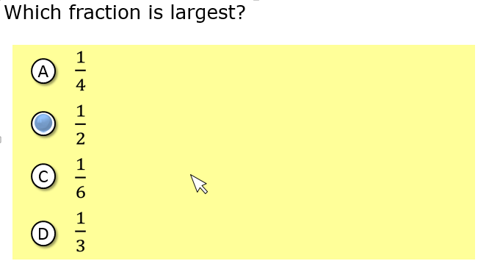
Item Types: Multiple Choice

Slide 10
Item Types: Constructed Response

Slide 11
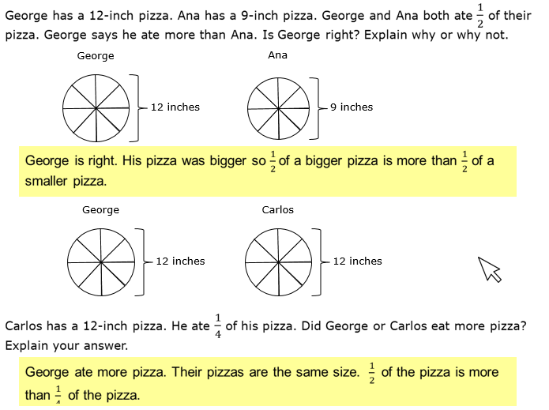
Item Types: Constructed Response

Slide 12
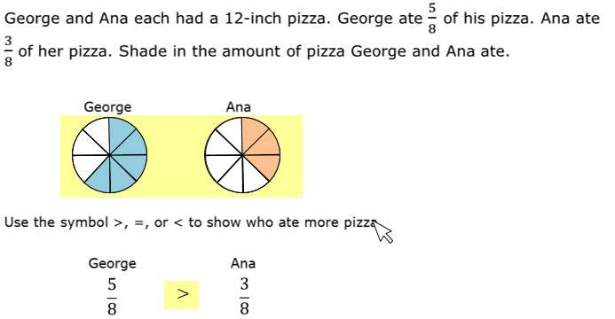
Item Types: Technology Enhanced

Slide 13
General Test parameters
ELA will consist of 3 sections, 1 of which will focus mainly on writing
Mathematics will consist of 2 sections
Science will consist of 2 sections
Social Studies will consist of 2 sections

Slide 14
General Test parameters: ELA
Criterion-Referenced
Total Number of Items: 44 / Total Number of Points: 55
Breakdown by Item Type:
40 Selected Response (worth 1 point each; 10 of which are aligned NRT)
2 Constructed Response (2 points each)
1 Constructed Response (worth 4 points)
1 Extended Response (worth 7 points)
Norm-Referenced
Total Number of Items: 20 (10 of which contribute to CR score)
Embedded Field Test
Total field test items: 6

Slide 15
General Test parameters: Writing at every Grade
All students will encounter a constructed-response item allowing for narrative prose, in response to text, within first or second section of the test.
Within the writing section of the test, students will read a pair of passages and complete a series of “warm-up” items:
3 selected-response items asking about the salient features of each passage and comparing/contrasting between the two passages
1 constructed-response item requiring linking the two passages
1 writing prompt in which students must cite evidence to support their conclusions, claims, etc.

Slide 16
General Test parameters: Writing at every Grade
Genres
Writing prompts will be informative/explanatory or opinion/argumentative depending on the grade level. Students could encounter either genre.
Students who simply rewrite excerpts from the passage(s) to illustrate their point(s) will not receive favorable scores.

Slide 17
General Test parameters: Mathematics
Criterion-Referenced
Total Number of Items: 53 / Total Number of Points: 58
Breakdown by Item Type:
50 Selected Response (worth 1 point each; 10 of which are aligned NRT)
2 Constructed Response (worth 2 points each)
1 Constructed Response (worth 4 points)
Norm-Referenced
Total Number of Items: 20 (10 of which contribute to CR score)
Embedded Field Test
Total field test items: 10

Slide 18
General Test parameters: Science
Criterion-Referenced
Total Number of Items: 55 / Total Number of Points: 55
Breakdown by Item Type:
55 Selected Response (worth 1 point each; approximately 10 of which are aligned NRT)
Norm-Referenced
Total Number of Items: 20 (approximately 10 of which contribute to CR score)
Embedded Field Test
Total field test items: 10

Slide 19
General Test parameters: Social Studies
Criterion-Referenced
Total Number of Items: 55 / Total Number of Points: 55
Breakdown by Item Type:
55 Selected Response (worth 1 point each; approximately 10 of which are aligned NRT)
Norm-Referenced
Total Number of Items: 20 (approximately 10 of which contribute to CR score)
Embedded Field Test
Total field test items: 10

Slide 20
Available resources
Content standards
frameworks, formative lessons, PARCC evidence statements
Sample items
formative items/benchmarks via Georgia OAS→GOFAR;
released items via PARCC, SBAC, other states (KY, NY), NAEP
parent’s guide to Georgia’s new assessment developed by the National PTA [http://www.pta.org/advocacy/content.cfm?ItemNumber=3816 ]
CRCT Readiness Indicators
Lexiles (as one indicator of text complexity)
Georgia Milestones GADOE website [http://www.gadoe.org/Curriculum-Instruction-and-Assessment/Assessment/Pages/Georgia-Milestones-Assessment-System.aspx]
Content Weights [http://www.gadoe.org/Curriculum-Instruction-and-Assessment/Assessment/Documents/Georgia_Milestones_Content_Weights_2014-15_FINAL.pdf]

